Slide 1
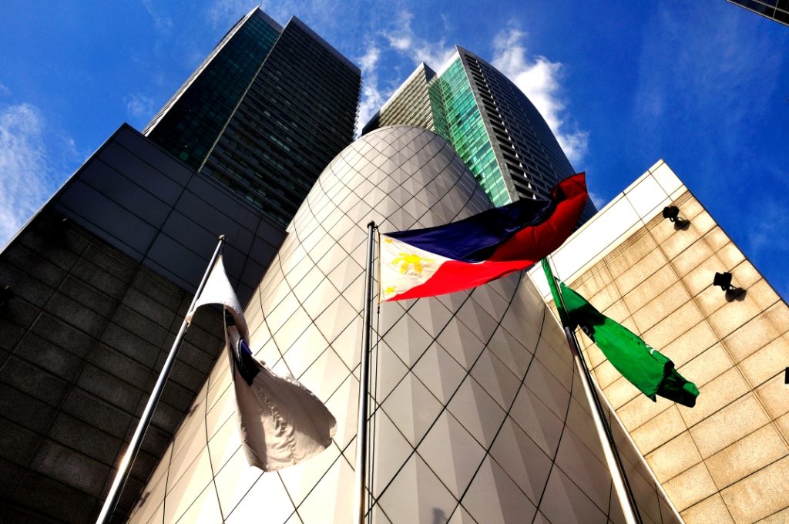
RCBC Plaza 2016 Fire Drill
Tenants’ Briefing Presentation

Slide 2
Agenda
Objectives
Building ERT Structure
PMO Fire Brigade Team
  Fire Brigade Team Leader and Members
  Evacuation Sites
Emergency Alarm Activation Flow Chart
Fire Drill Announcement/Scenario
Building Emergency Equipment

Slide 3
Objectives:
To test RCBC Plaza’s Emergency Procedures
To test operational capabilities of RCBC Plaza’s emergency facilities, equipment and devices.
To familiarize Building Management staff and its occupants on the existing Emergency Procedures and emergency facilities, equipment, and devices.
Assess RCBC Plaza’s management team and tenants’ safety awareness and preparedness in relation to the existing emergency procedures and building emergency facilities, equipment, and devices.
To enable RCBC Plaza’s management team and tenants to determine safety aspects which need improvement.
Notes:
4th bullet
Gauge our facility, procedure, equipment if we are ready or not --- eventually identify the needs for improvement

Slide 4
ERT STRUCTURE
EMERGENCY RESPONSE TEAM CHAIRMAN
ERT LEADER
ERT CO-LEADER
FIRST
RESPONSE TEAM
FIRE BRIGADE/
FIRE FIGHTING
TEAM
RESCUE/
EVACUATION
TEAM
CROWD
CONTROL TEAM
MEDICAL/
FIRST AID
TEAM
SECURITY &
COMMUNICATION
TEAM
TRAFFIC
CONTROL TEAM
ENGINEERING
TEAM

Slide 5
RCBC PLAZA FIRE BRIGADE
ORGANIZATIONAL STRUCTURE
Fire Brigade Chief
Communication Team
Fire Fighting Team
Evacuation Team
Security & Traffic Team
Rescue & Salvage Team
Safety Officer
Fire Safety Personnel
Deputy Fire Brigade Chief
First Aid Team
Floor Marshal
Floor Marshal
Floor Marshal
Floor Marshal
Floor Marshal
Floor Marshal
Floor Marshal
Floor Marshal
Floor Marshal
Floor Marshal
TOWER 1
TOWER 2
1F
2F
3F
….
48F
1F
2F
3F
…
42F
Evac Guide (2)
Evac Guide (2)
Evac Guide (2)
Evac Guide (2)
Evac Guide (2)
Evac Guide (2)
Evac Guide (2)
Evac Guide (2)
Evac Guide (2)
Evac Guide (2)

Slide 6
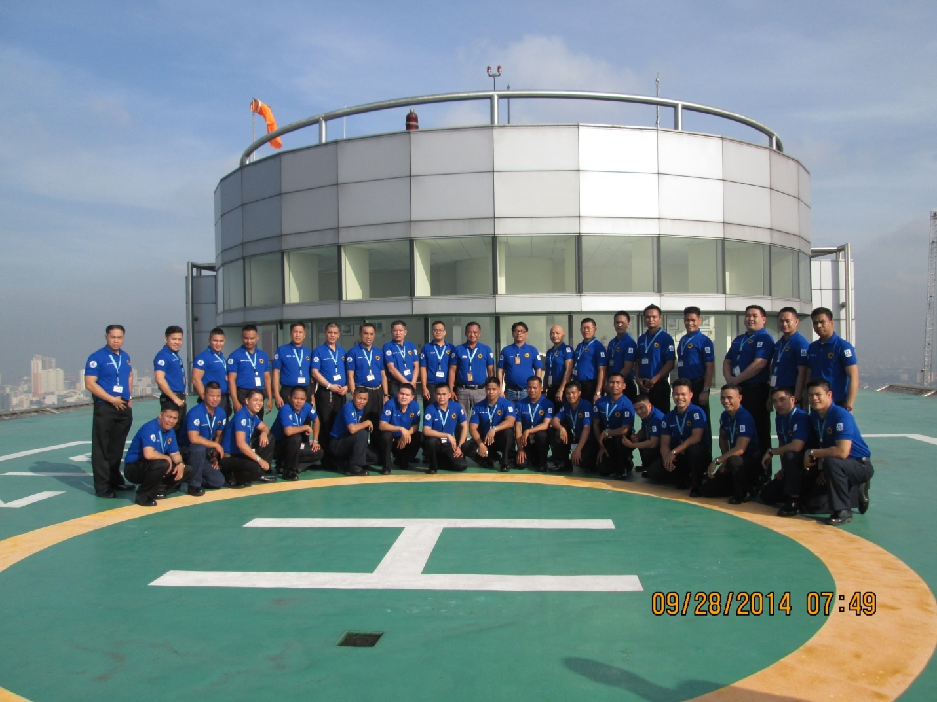
Emergency Response Team

Slide 7
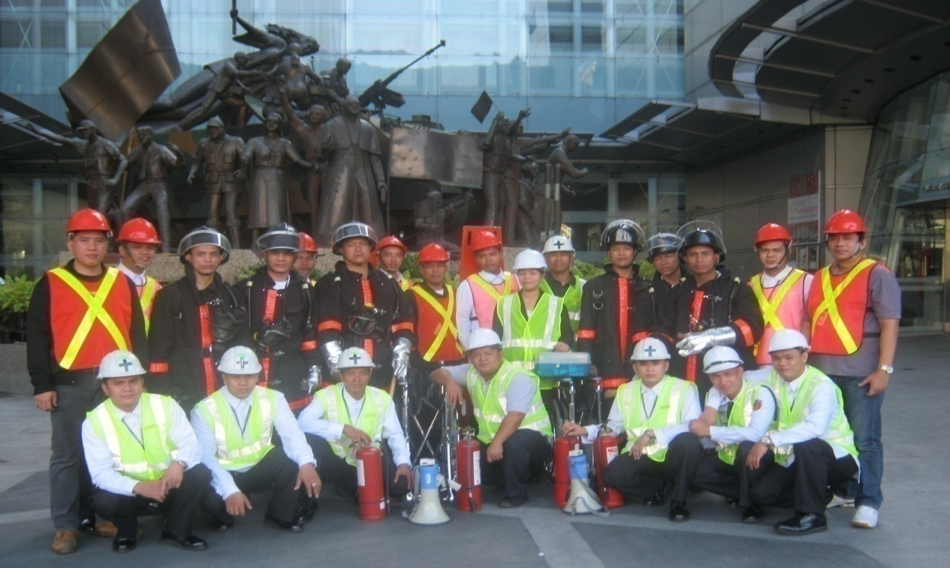
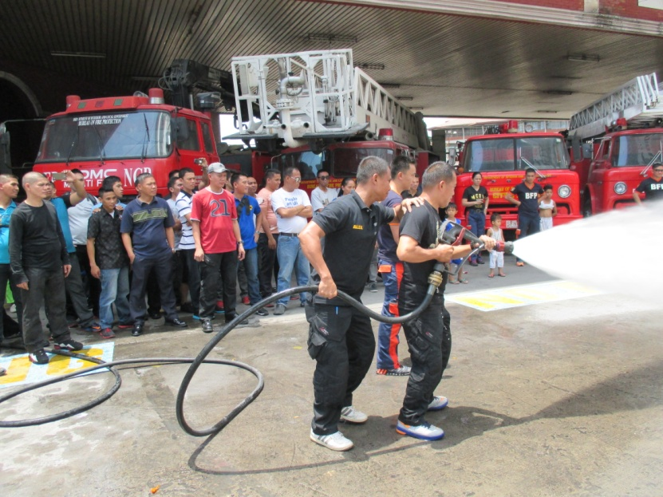
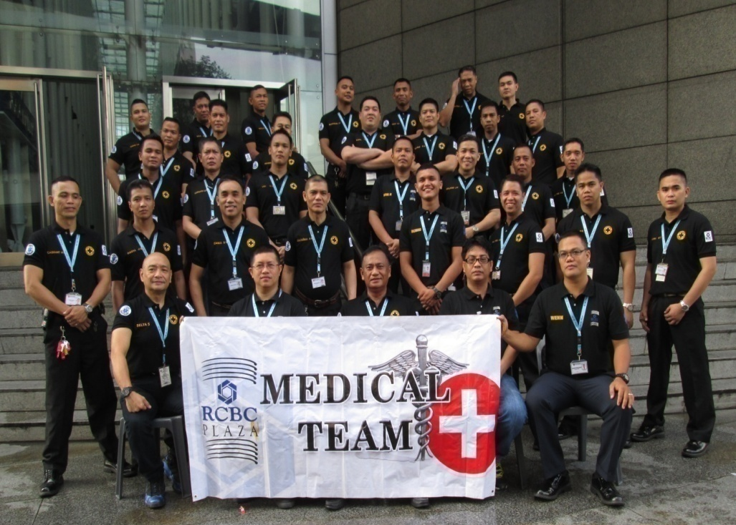
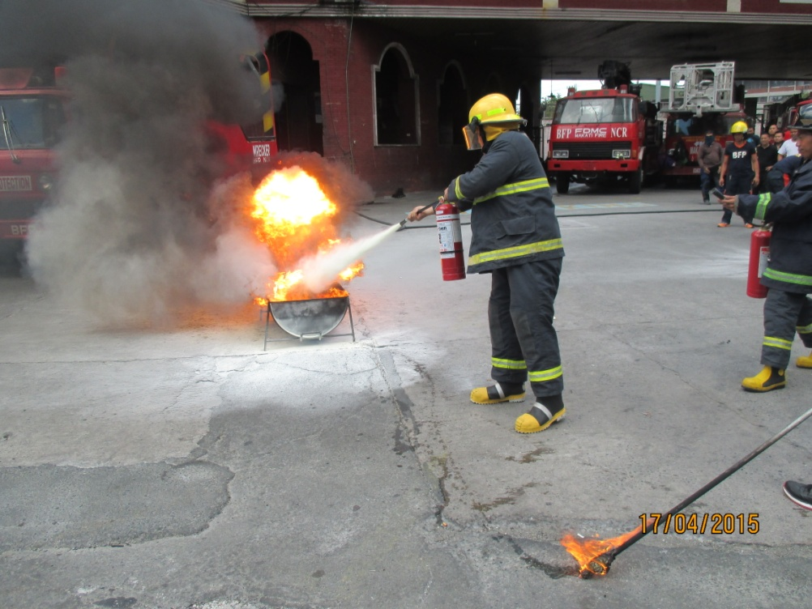
Fire Brigade Team

Slide 8
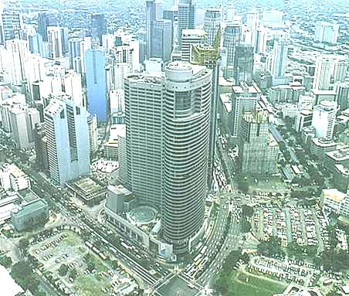
Evacuation Areas
EVACUATION CENTER “CHARLIE”
Buendia Avenue
AREA ADJACENT TO MMC
Ayala Avenue
EVACUATION CENTER “DELTA”
EVACUATION
CENTER
“BRAVO”
Gil Puyat Ave.
THE COLUMNS
Ayala Ave.
PEOPLE SUPPORT
EVACUATION CENTER “ECHO”
COMMAND POST
“ALPHA”

Slide 9
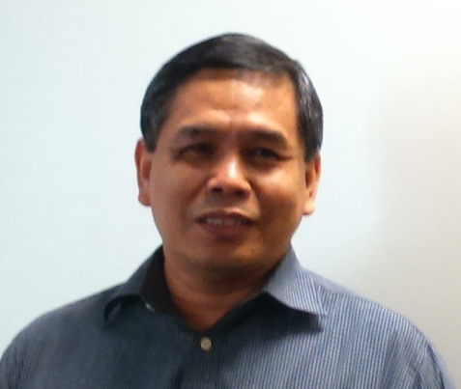
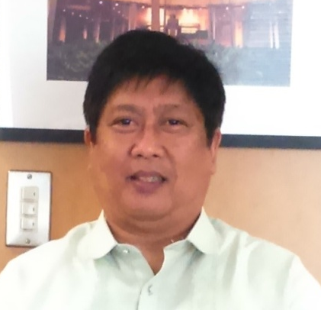
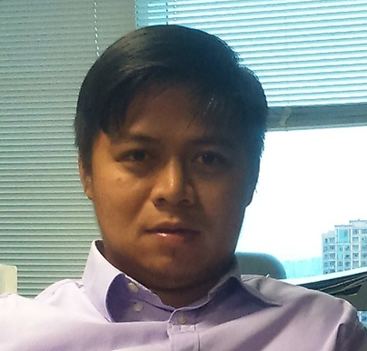

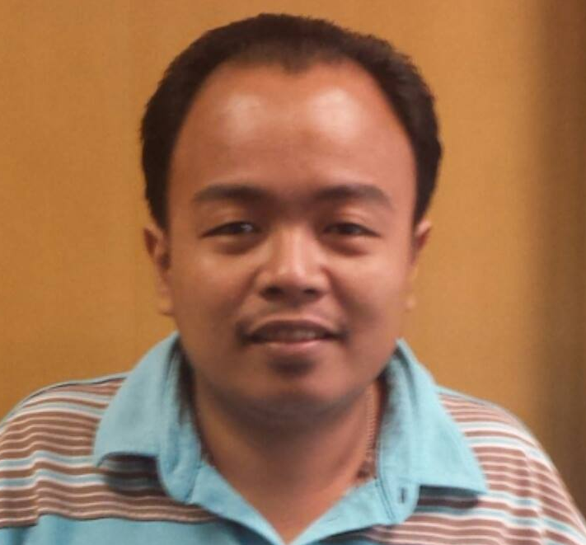
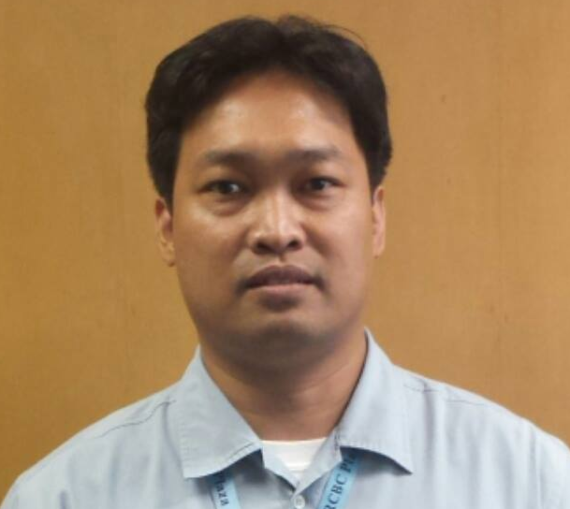
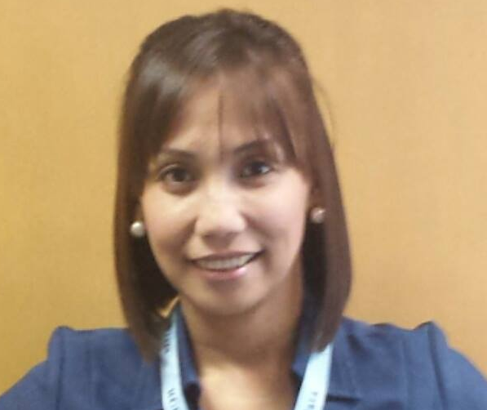
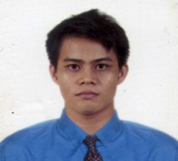
PMO Fire Brigade Team
Fortunato Revillas
Asst. Fire Marshall
Evaristo Medina
Fire Marshall
Rico C. Manalo
Safety Officer
TEAM ALPHA
Mark Serafines
Team Leader
Michael Estrada
Team Leader
Au Placio
Team Leader
Wilfred Castro
Team Leader
TEAM BRAVO
TEAM CHARLIE
TEAM DELTA
TEAM ECHO

Slide 10
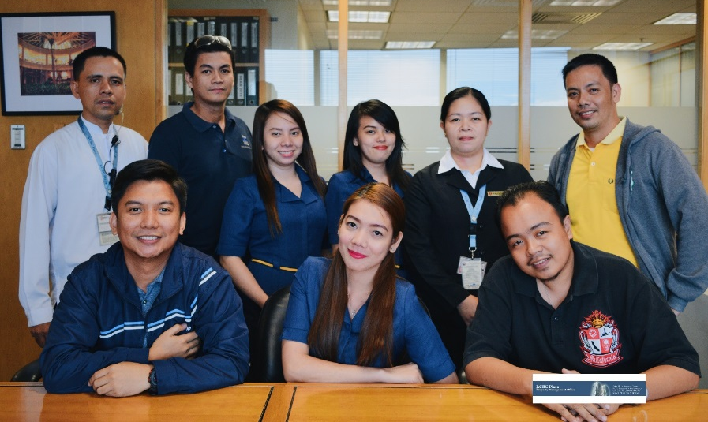
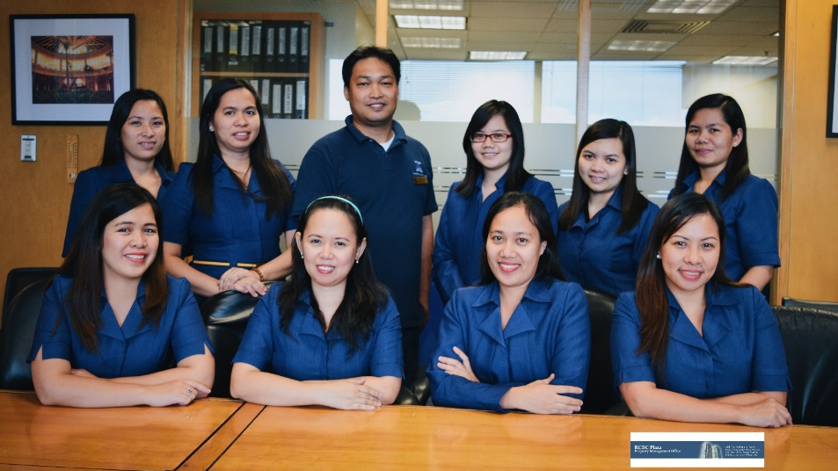
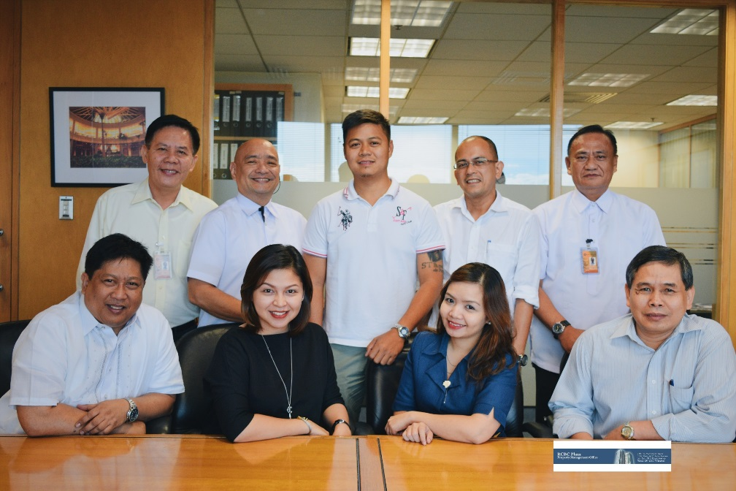
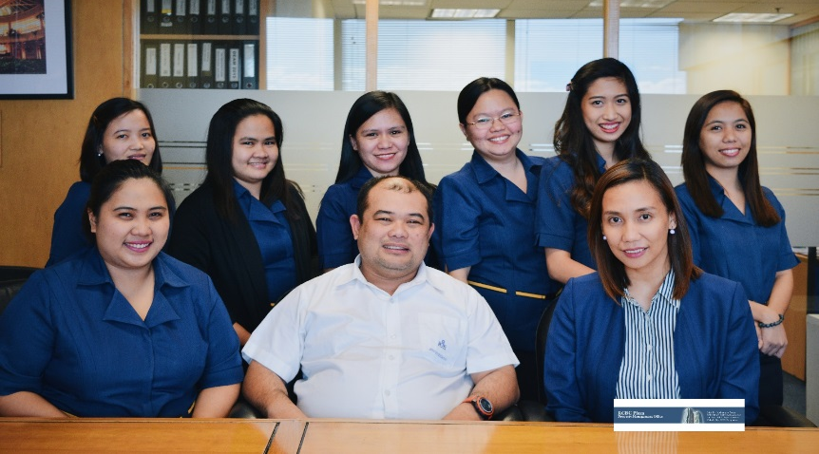
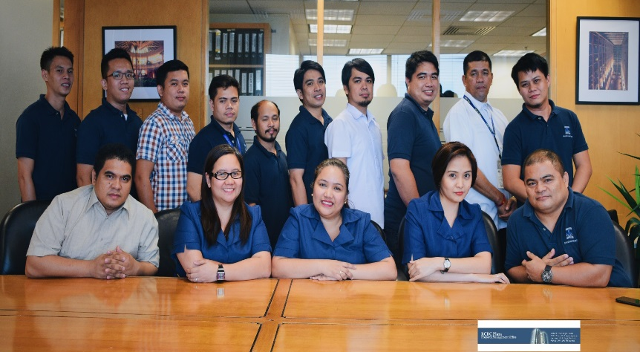
Team Bravo
Team Charlie
Team ALPHA
Team Delta
Team Echo

Slide 11

Team ALPHA

Slide 12

Team Alpha
Evaristo Medina – Fire Marshall
Fort Revillas – Assistant Fire Marshall
Rico C. Manalo – Safety Officer
Bert Sumagaysay – Chief Engineer
  Advisor on Building and Facility System
Pol Pe Benito – Technical Manager
  Architectural & Civil Works
Jonah Ramirez – Tenant Relations Manager
Ana Marie Mangampo - Help Desk
Nurses - Medical Team support from Grepalife Clinic

Slide 13
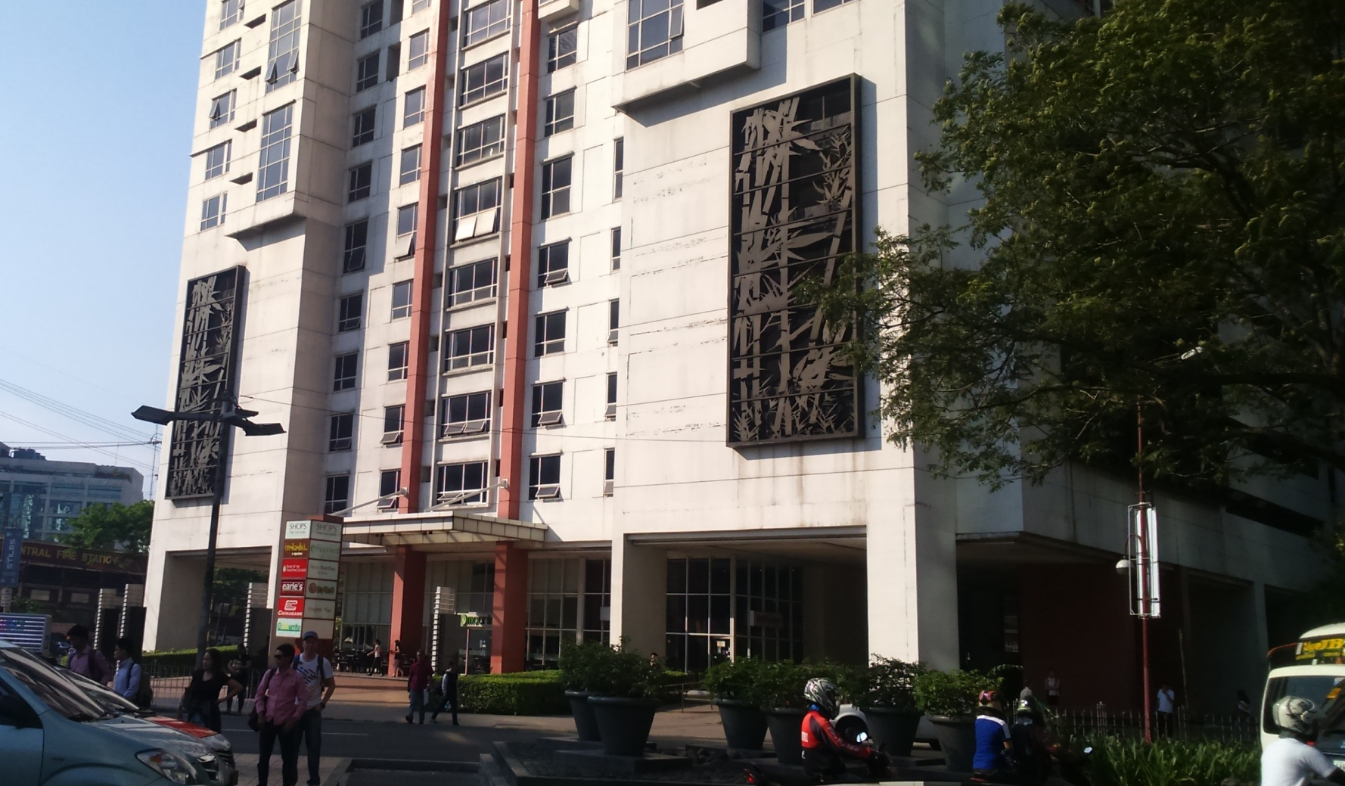
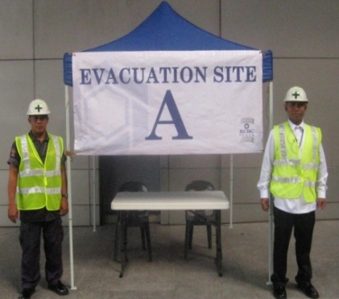
Team ALPHA
Team Alpha command post located at the Ayala corner perimeter of
The Columns

Slide 14
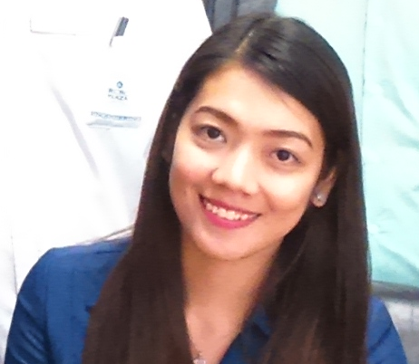
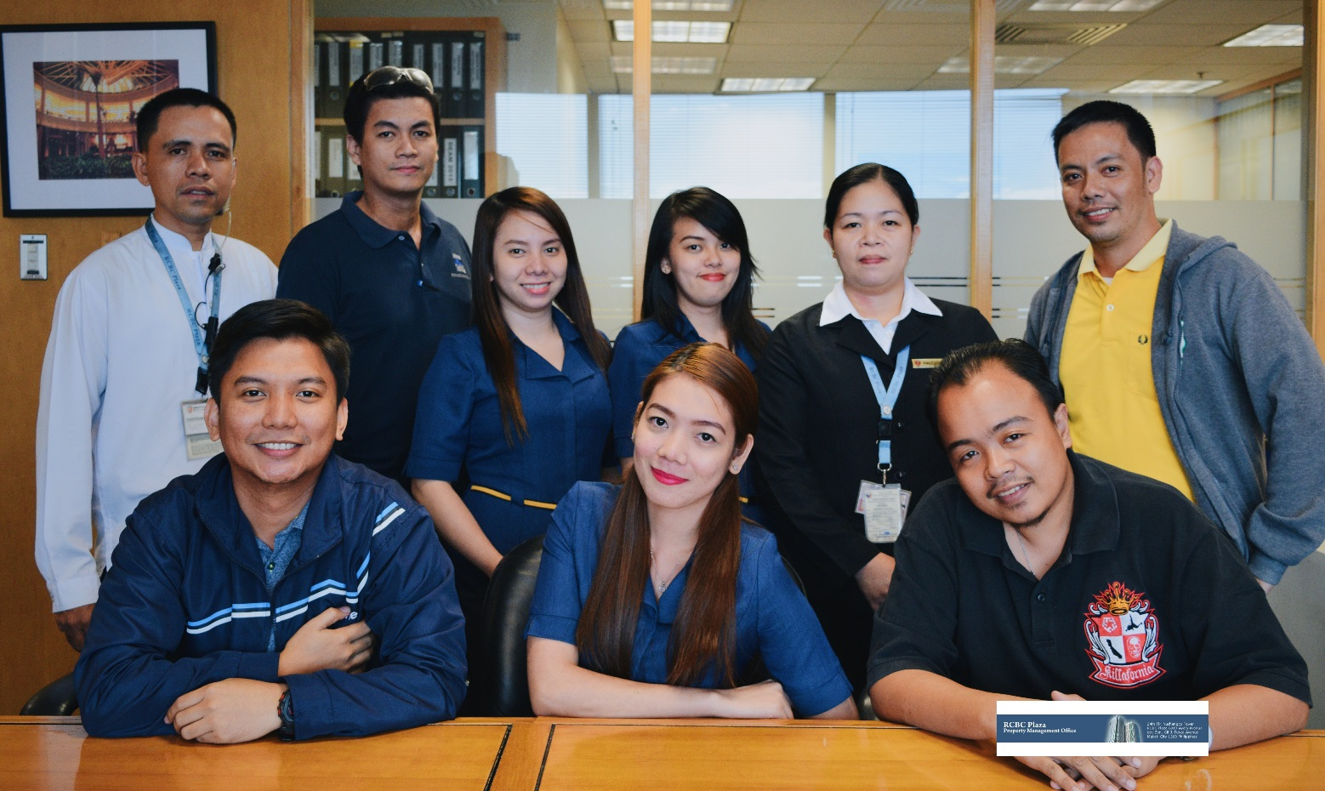
Engr. Mark Serafines
Team Leader - Bravo
Ma. Cristina Torres
Asst. Team Leader - Bravo
BRAVO TEAM
Team Bravo

Slide 15
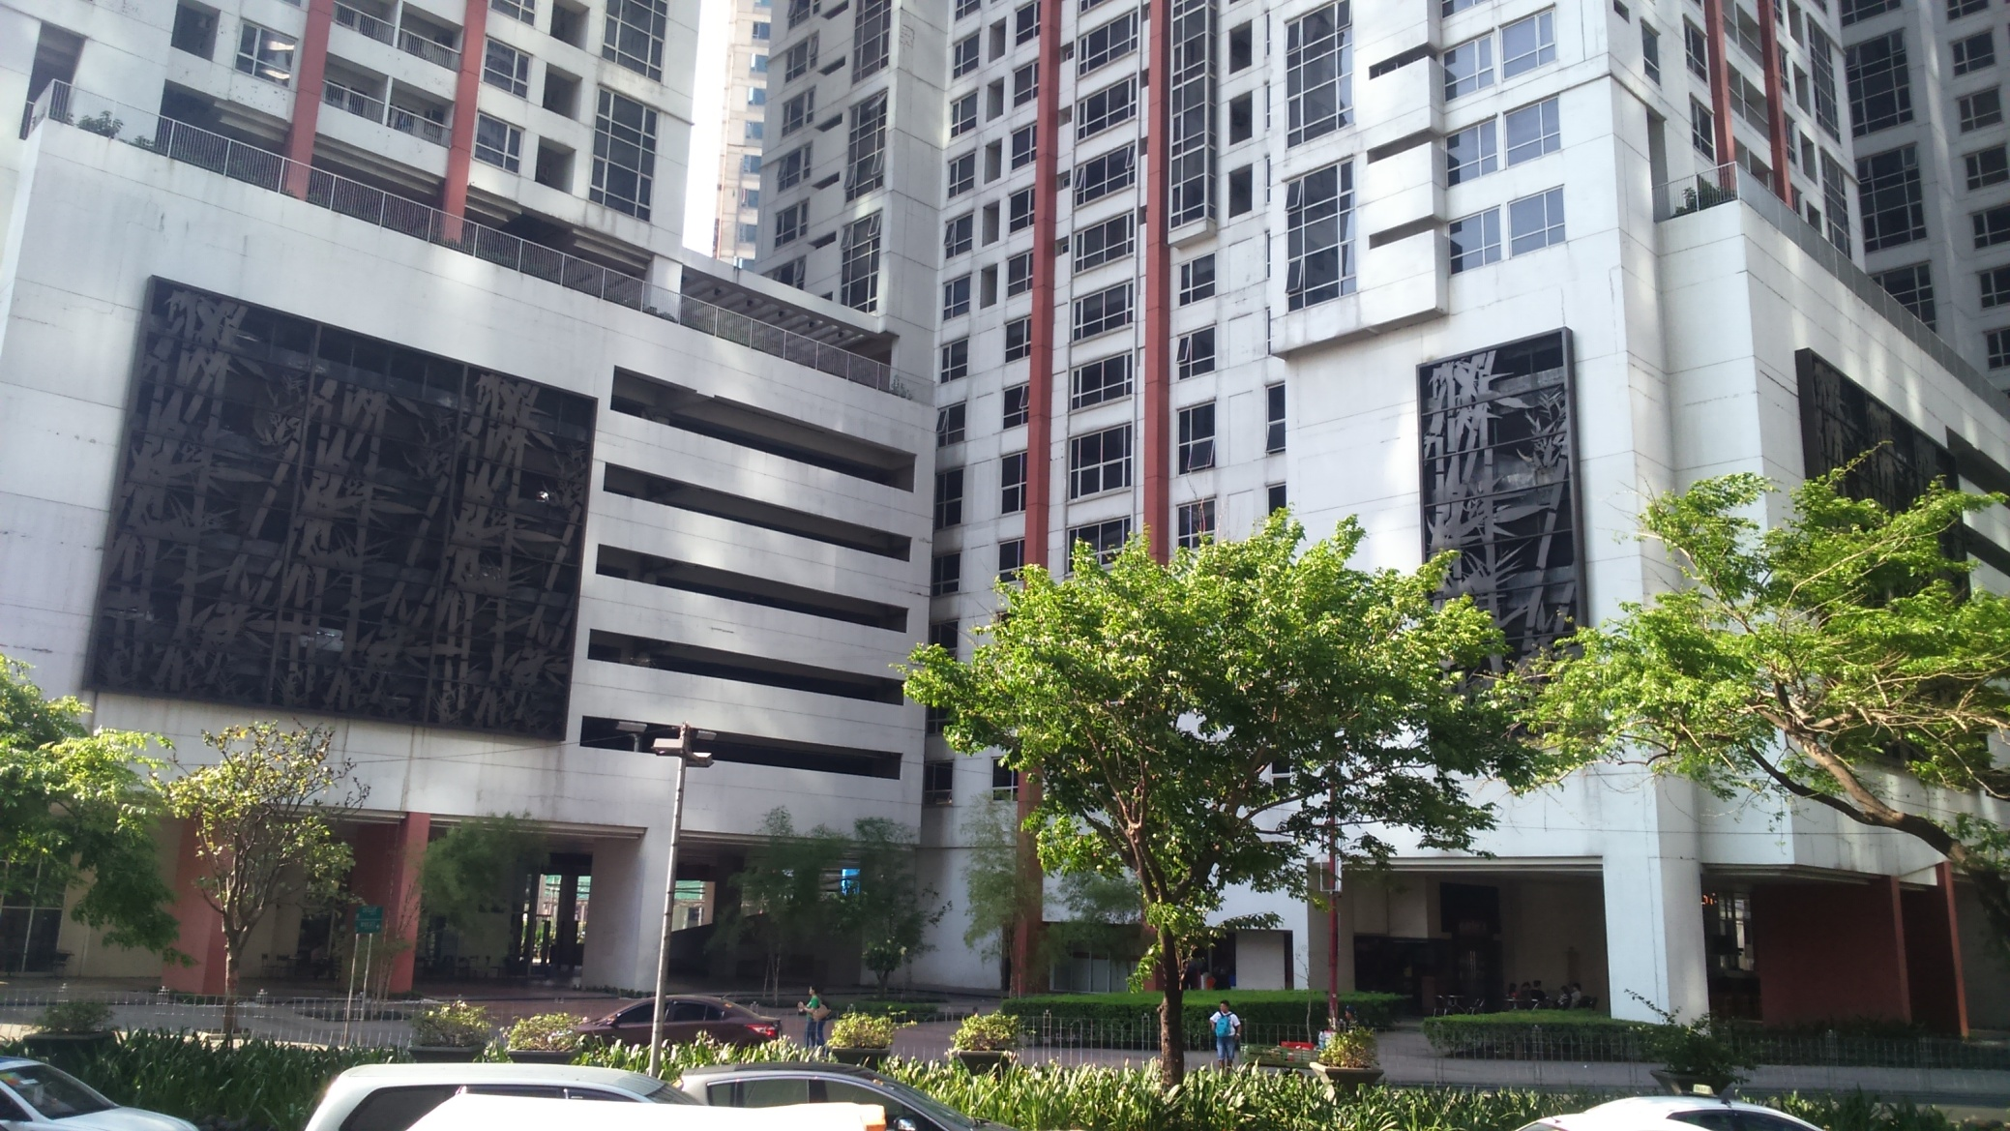
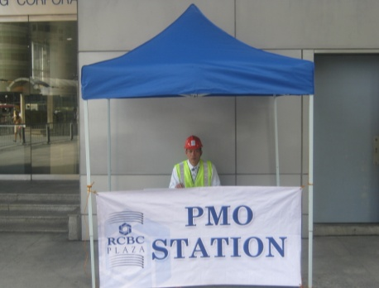
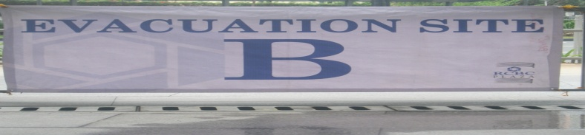
Bravo Evacuation Site
Team Bravo command post located at the center perimeter of
The Columns along Gil Puyat Ave.

Slide 16
Team Bravo - Tenants
BRAVO
EVACUATION SITE
All tenants on the following floors of
Yuchengco Tower shall proceed to Bravo:
Tenants with multiple leased premises on different zones
and/or Tower, hence, have different evacuation site assignments,
should inform the Building Management if they intend to elect just one
assembly point and evacuation site.
Yuchengco Tower
Mid Rise | High Rise
25th to 32nd | 33rd to 48th

Slide 17
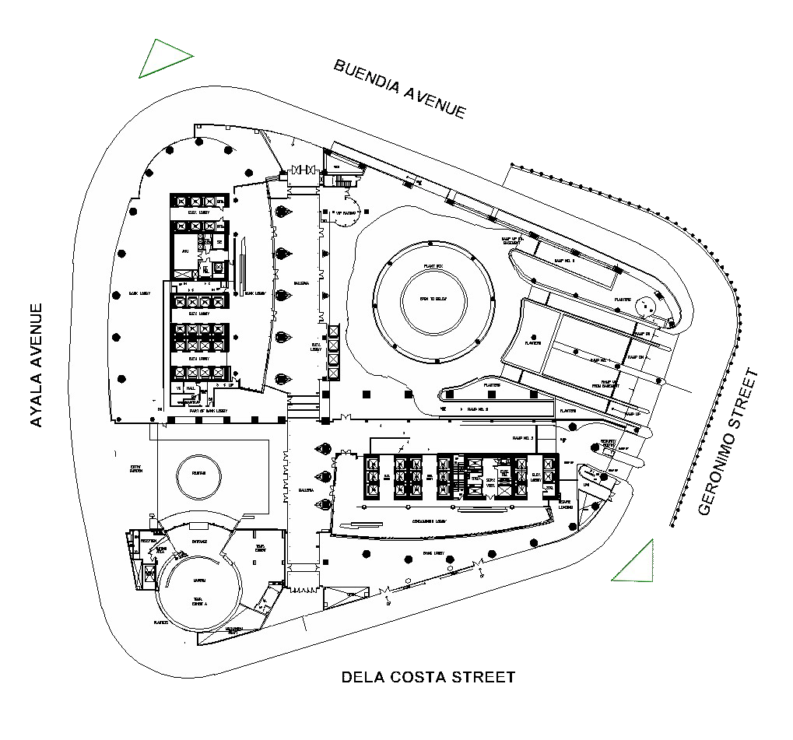

EVACUATION
AREA
“BRAVO”

Slide 18
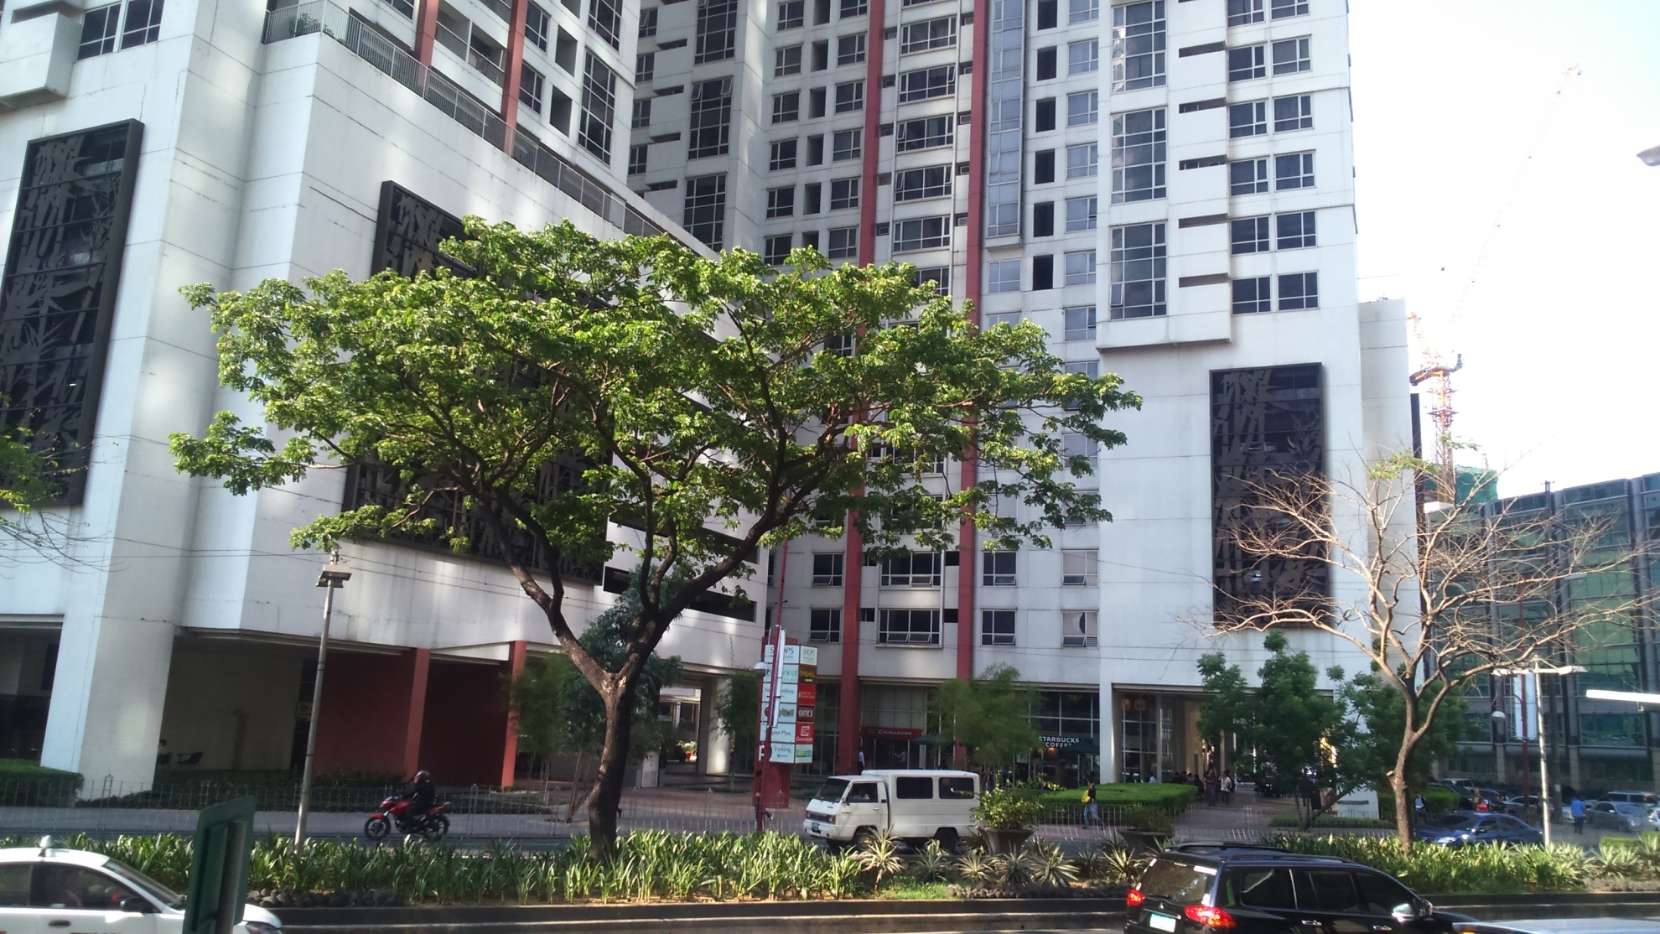
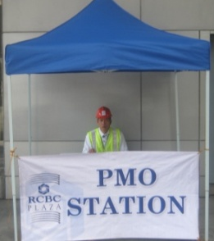
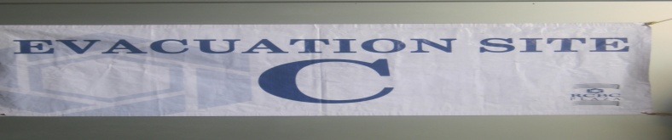
Charlie Evacuation Site
Team Charlie command post located on the farthest corner of
The Columns along Sen. Gil Puyat Ave.(near Zuellig Loop)

Slide 19
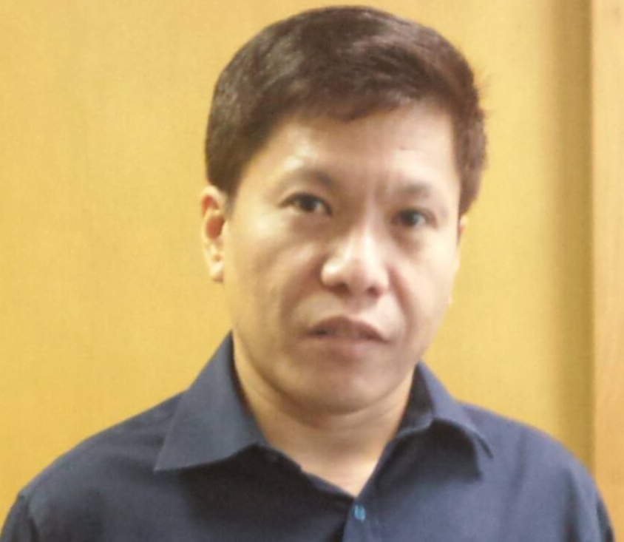
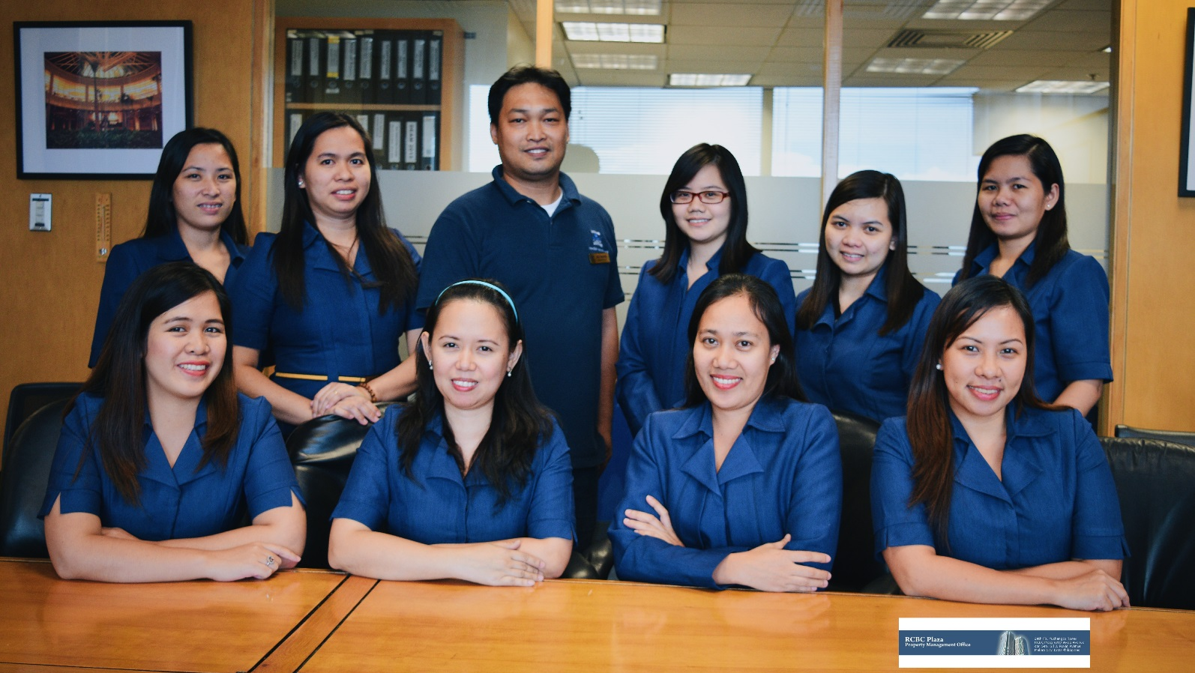
Michael Estrada
Team Leader - CHARLIE
Rico Reyes
Asst. Team Leader - CHARLIE
CHARLIE TEAM
Team Charlie

Slide 20
Team Charlie - Tenants
All tenants on the following floors of
Yuchengco Tower shall proceed to Charlie:
Tenants with multiple leased premises on different zones
and/or Tower, hence, have different evacuation site assignments,
should inform the Building Management if they intend to elect just one
assembly point and evacuation site.
CHARLIE EVACUATION SITE
Yuchengco Tower
Low Rise | Mid Rise
Ground to 17th | 18th to 26th

Slide 21
EVACUATION
AREA
“CHARLIE”

Slide 22
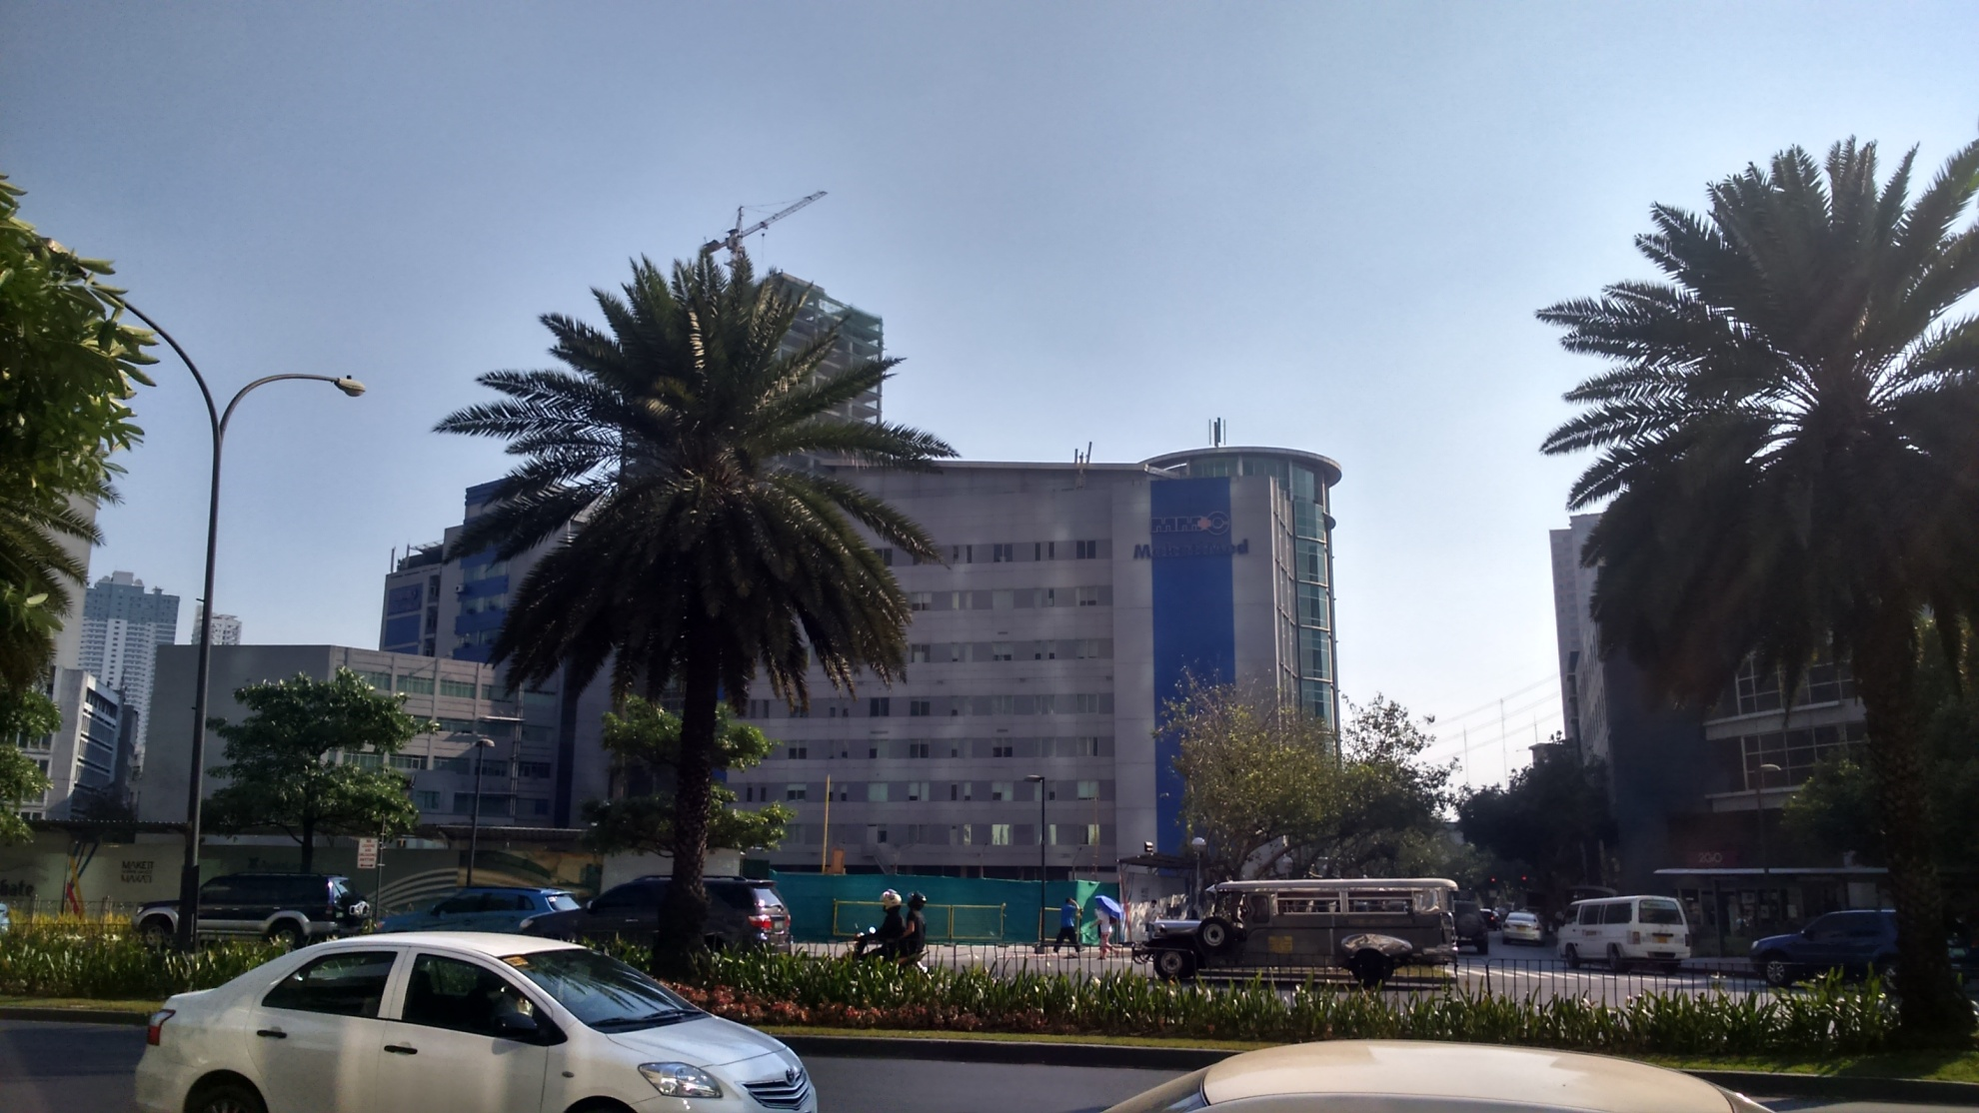
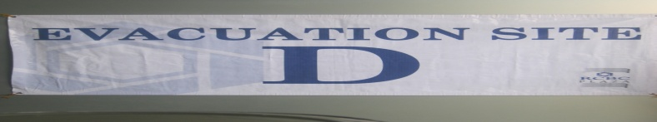
Delta Evacuation Site
Team Delta command post located on the sidewalk adjacent to MMC along Ayala Ave.

Slide 23
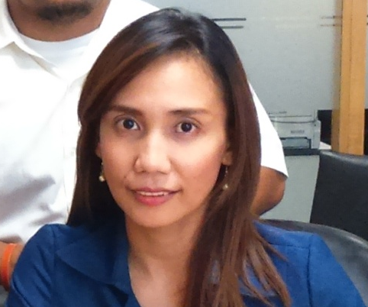


Au Palacio
Team Leader - Delta
Febregs Solas
Asst. Team Leader - Delta
DELTA TEAM
Team Delta

Slide 24
Team Delta - Tenants
All tenants on the following floors of
Tower II shall proceed to Delta:
Tenants with multiple leased premises on different zones
and/or Tower, hence, have different evacuation site assignments,
should inform the Building Management if they intend to elect just one
assembly point and evacuation site.
DELTA
EVACUATION SITE
Tower II
Low Rise | Mid Rise
Ground to 11th | 30th
All Podium 4 Retail Tenants | 22nd to 25th
All Podium 3 Retail Tenants

Slide 25
EVACUATION
AREA
“DELTA”

Slide 26
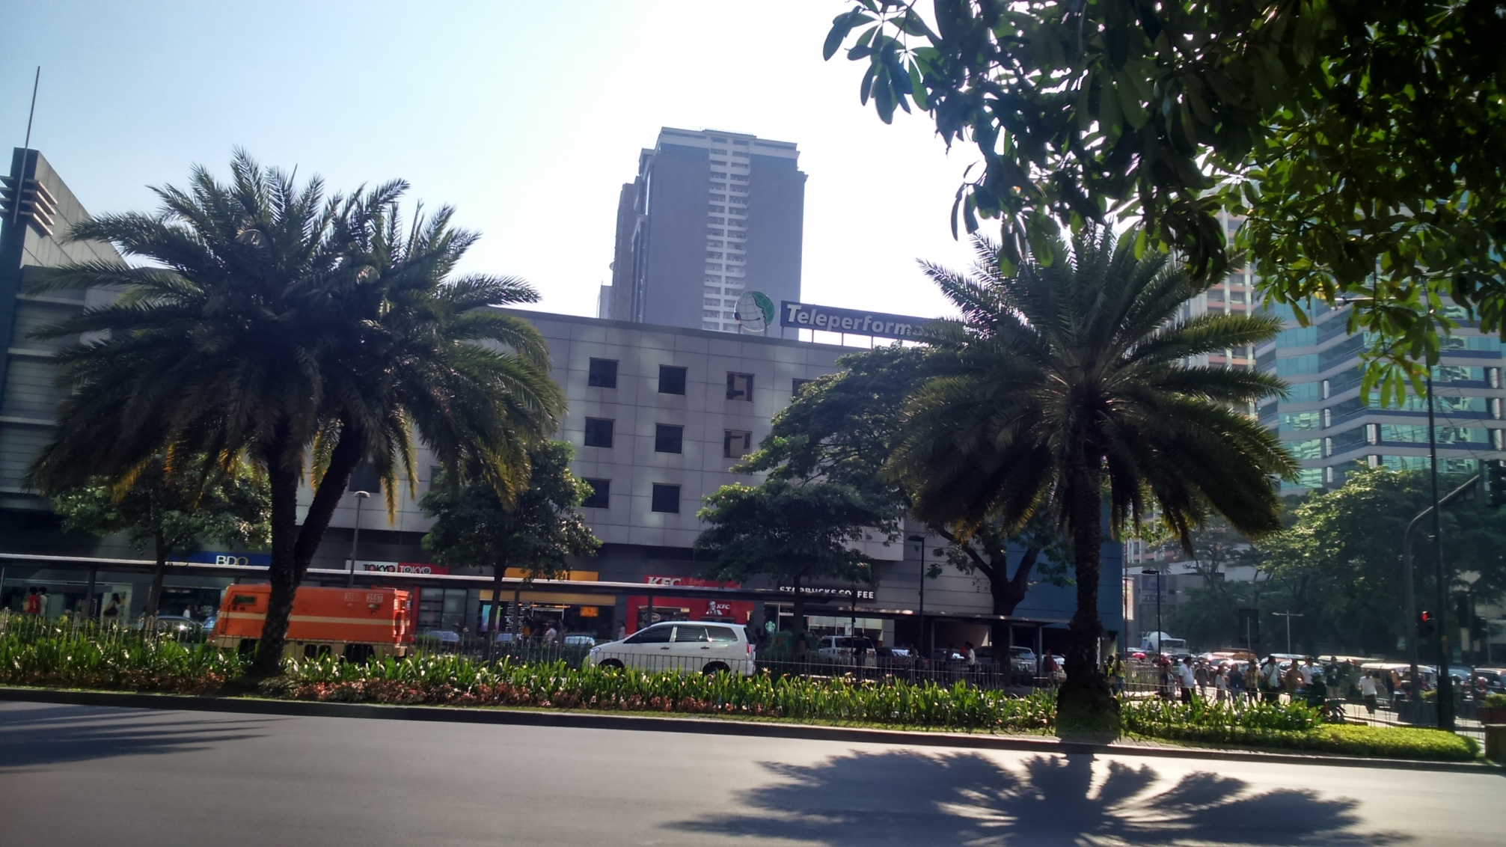

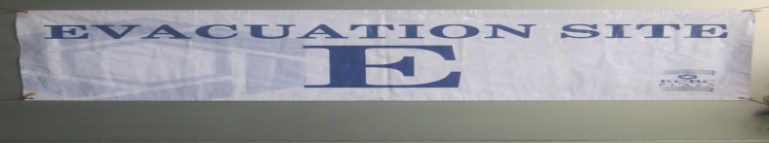
Echo Evacuation Site
Team Echo command post located on the sidewalk adjacent to
People Support building along Ayala Ave. corner Gil Puyat Ave.

Slide 27
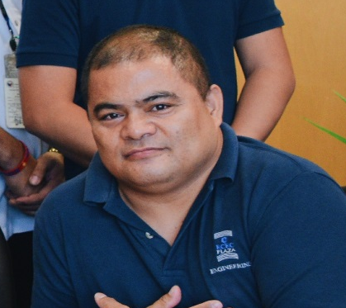





Wilfred Castro
Team Leader - ECHO
Jimmy Areno
Asst. Team Leader - ECHO
Team Echo

Slide 28
Team Echo - Tenants
All tenants on the following floors of
Tower II shall proceed to Echo:
Tenants with multiple leased premises on different zones
and/or Tower, hence, have different evacuation site assignments,
should inform the Building Management if they intend to elect just one
assembly point and evacuation site.
ECHO
EVACUATION SITE
Tower II
Low Rise | Mid Rise | High Rise
14th to 17th | 18th to 21st | 31st to 41st
Museum | 26th to 29th

Slide 29
EVACUATION
AREA
“ECHO”

Slide 30
COMMAND POST
“ALPHA”
EVACUATION
CENTER
“BRAVO”
EVACUATION
CENTER
“CHARLIE”
EVACUATION
CENTER
“ECHO”
EVACUATION
CENTER
“DELTA”

Slide 31
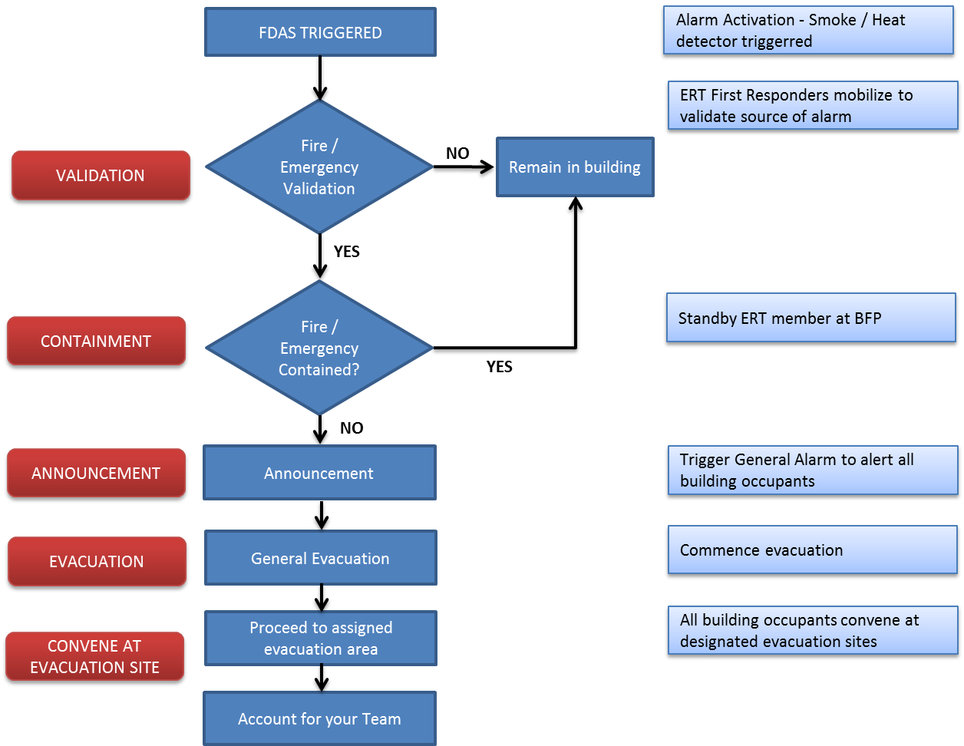
Emergency Alarm Activation

Slide 32
Drill Scenario

Slide 33
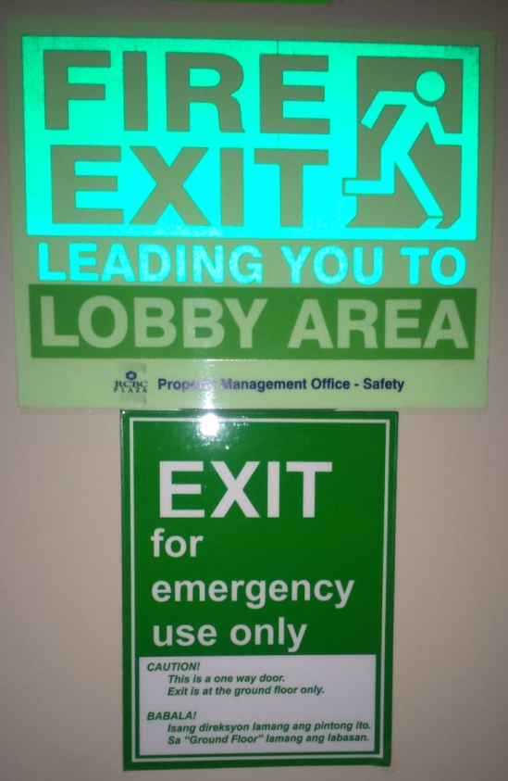
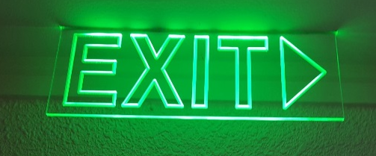
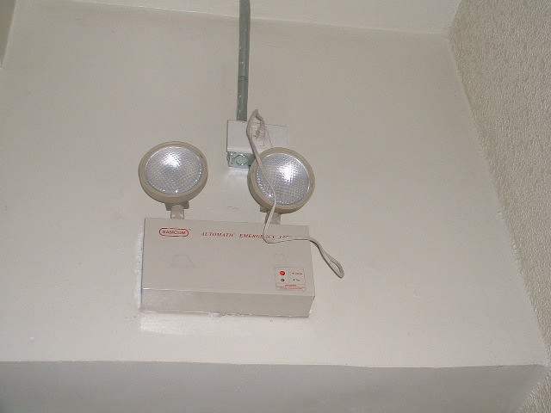
Building Emergency
Equipment

Slide 34
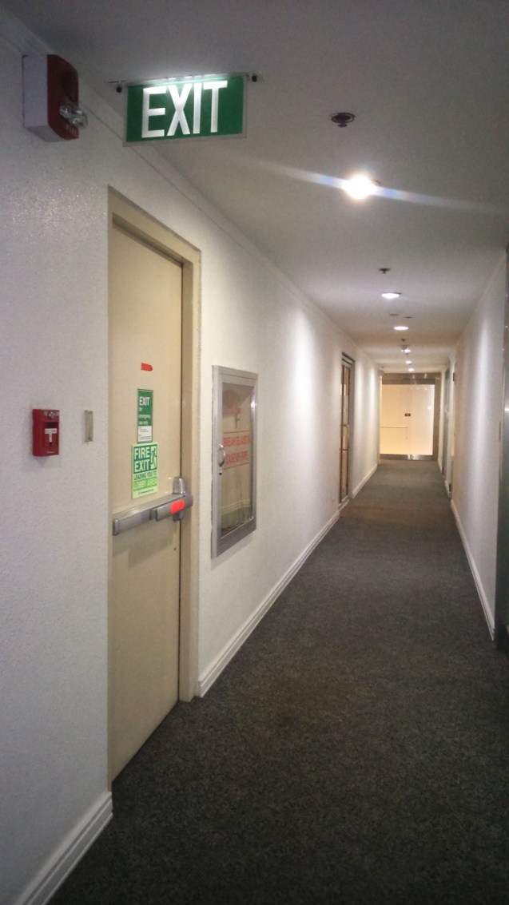
Know your nearest Fire Exits
NOTE: Do not obstruct Fire Exit at all times

Slide 35
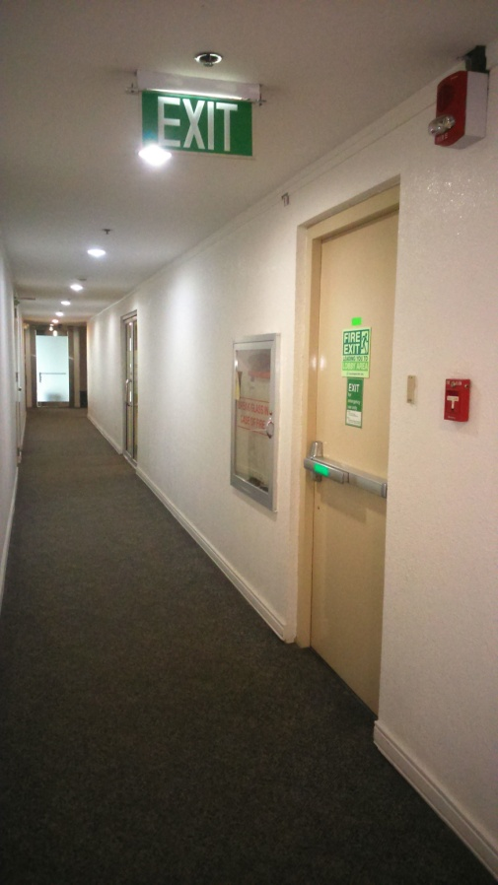

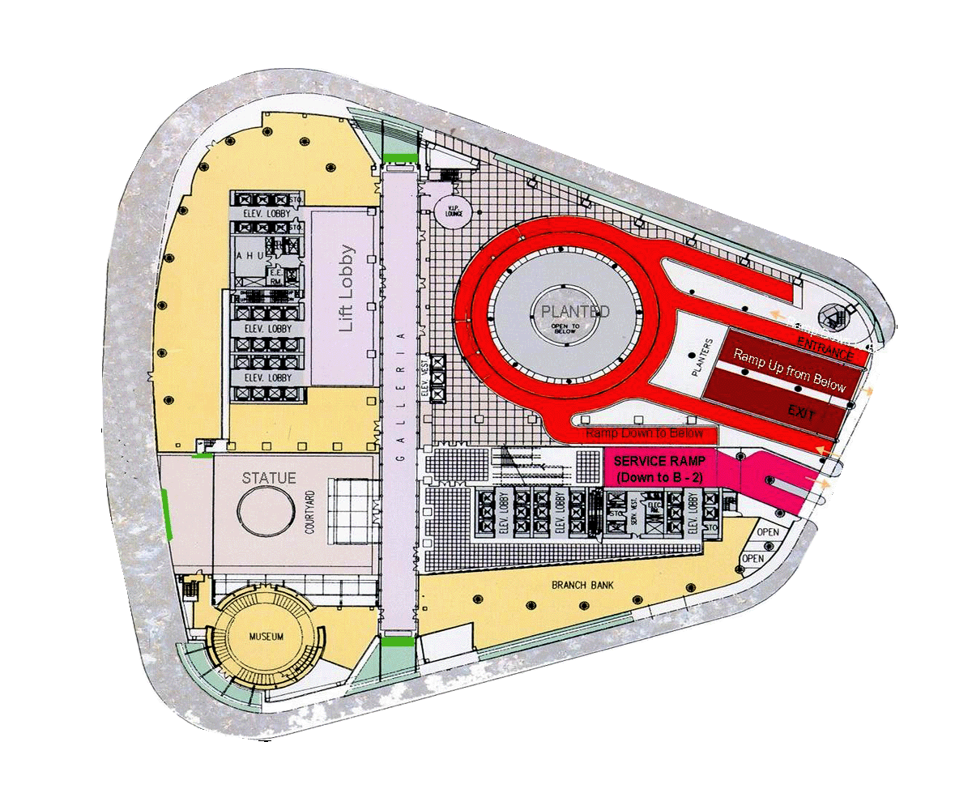
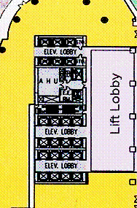
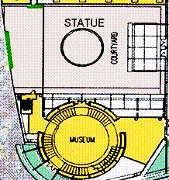
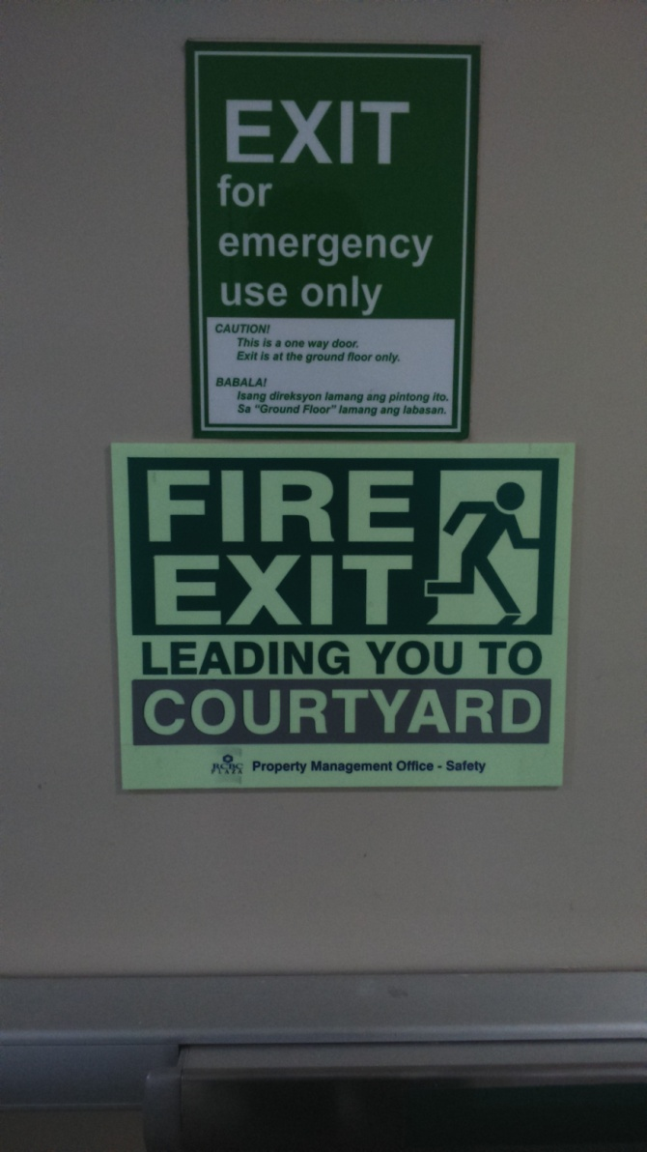
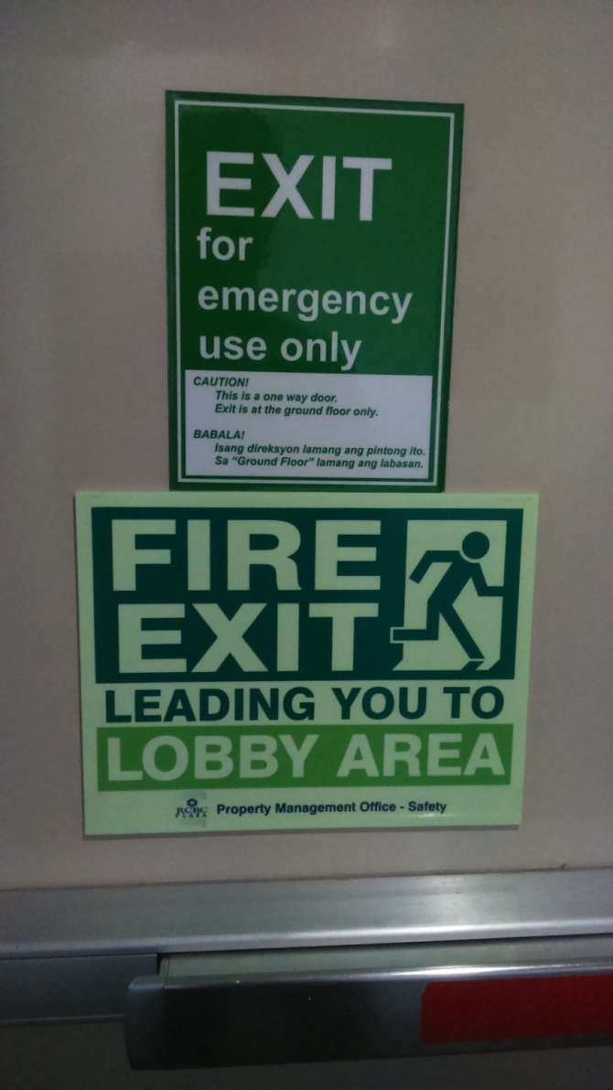
Yuchengco Tower
Buendia Avenue
Ayala Avenue
Geronimo
Dela Costa

Slide 36

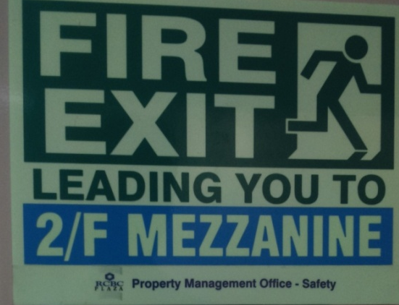

Tower 2
Buendia Avenue
Ayala Avenue
Geronimo
Dela Costa

Slide 37

Hallway Fire Exit and Directional Signs
Tower 1 Fire Exits leads you to;
  Courtyard
  Tower 1 Lobby area

Slide 38


Hallway Fire Exit and Directional Signs
Tower 2 Fire Exits leads you to;
  2/F Mezzanine
  Tower 2 Lobby area

Slide 39





Slide 40




Emergency Lights
Situated at 4 corners of hallways
Tower 1 Lobby – LED Lights
Tower 2 Lobby – Lighting with UPS
Notes:
Incase of Power Failure or Fluctuation, we have strategically allocate an Emergency Lights on all common areas of the building including;
Each floor hallways
Tower 1 Lobby
Tower 2 Lobby

Slide 41


Fire Escape Stairs
  Hold the handrail while traversing the Fire Escape Stairwells

Slide 42
THINGS TO REMEMBER DURING EVACUATION
Do not PANIC. We are practicing an orderly evacuation.
  People Are Not Informed Correctly
Homing of elevators will be implemented during evacuation --- Make use of the Fire Escape.
Walk or Move fast but do not run.
Do not operate your gadgets while inside the fire escape – Do not cause congestion to others.
Be careful and watch your steps
Hold the hand rail while descending the fire escape
Be aware of signages and instructions.
Proceed to your designated evacuation area --- Take note of the COLOR CODED FLAGS at each evacuation site.
Be extra careful of your belongings.

Slide 43
AT THE EVACUATION AREA…
Line up with your respective Team.
Your designated Floor Fire Marshalls shall account the total evacuees of your respective Team/Company.
Coordinate with PMO Fire Marshall
  Tenants Fire Marshall:
  Shall submit the Tenants Info Sheet Summary
Wait for further instructions

Slide 44
Tenant’s Information
Floor Marshall: ___________________
Coordinator/runner: ___________________
Company: ___________________
Tower/Level: ___________________
Evacuation Area: ___________________
Total number of employees: ___________
Total number of persons evacuated: _________
PWD/Senior/Pregnant: ____________________
In an actual evacuation, you have to inform your respective PMO Fire Marshalls if there are personnel who didn’t make it to the evacuation area.

Slide 45
RETURN TO THE BUILDING PROCESS
Return to building will be done according to Evacuation Site.
An ERT will wave a flag to signify that Fire exits are clear of evacuees.
  Orange Flag for Tower 1
  Yellow Flag for Tower 2
A foghorn will be sounded to call attention.
A Green flag and the 1st letter of each evacuation site will be waved at the building perimeter to signal the return process
  ‘B’ for Bravo , ‘C’ for Charlie – to be waved by an ERT at Buendia Side
  ‘D’ for Delta , ‘E’ for Echo – to be waved by an ERT at Ayala Side
NOTE: Wear your Company ID upon entering as part of Security procedures

Slide 46


Tower 1
Fire Exit Clearing Team

Slide 47


Tower 2
Fire Exit Clearing Team

Slide 48


return to the building signal...
EVACUEES AT SITE “BRAVO” MAY NOW RETURN TO THE BUILDING
A marine foghorn will be sounded to call attention
The GREEN FLAG means: “Return to building.
The “B” means: “Only those at Site BRAVO”

Slide 49
Key Expectations
11 Simple steps for a perfect simulation of an Emergency
Be aware of signal & alarm
Follow voice instructions
Know your nearest Fire Exits
Use fire escape – hold the hand rail properly
Lead your Team/company during evacuation process
Convene at your designated evacuation sites
Account your Team - headcounting
Provide summary of headcount to PMO Fire Marshalls – Make use of Tenants Info Sheet
Wait for signal on returning to the building per evacuation sites.

Slide 50
Reminders
  Rehydrate frequently, there are water dispenser available on each designated evacuation area.
  Follow traffic constable assigned before crossing the street
  Close coordination with PMO Fire Brigade Team
    Know your respective PMO Fire Marshalls
    Submit summary of headcount
  Retail outlets are required to participate as well
    Failure will mean deny of endorsements in securing Fire Safety Inspection Certificate from BFP-Makati
    We highly encourage majority of your employees to participate.

Slide 51
Reminders
  Car access including elevator access will be temporarily on queue for few minutes
    Tenants respective visitors will be instructed to temporarily stay on Basement level lobby while the drill is ongoing
Building AHU’s will be temporarily ‘Off’ for few minutes while the SEF and SPF will be enabled for testing
  AHU – Air Handling Unit
  SEF – Smoke Extraction Fan
  SPF – Smoke Pressurization Fan

Slide 52
Calendar of Activities
April 12, 2016
  2PM-3:30PM – BFP Fire Refresher Course
  3:30-4:30PM – Tenants Briefing Session
    Venue: YIAS Case Room
April 13, 2016, 10AM-12PM – LGU Coordination Meeting
  Venue: YIAS rm. 508
April 14, 2016, 2PM-4PM Earthquake Preparedness Seminar
  Venue: CPR Auditorium
April 19, 2016, Fire and Evacuation Drill – Day Operations
  Post drill Meeting with LGU venue: YIAS room 508
April 20, 2016, 10AM-12PM – Post Drill Meeting with Tenants
  Venue: YIAS Case Room
April 22, 2016, Fire and Evacuation Drill – Night Operations
  Post drill venue: Basement 5 Training room

Slide 53
RCBC-PLAZA PMO TRUNK LINE
887-4941
Helpdesk local 121

Slide 54
THANK YOU FOR YOUR PARTICIPATION
HAVE A SAFE DAY AHEAD

